Slide 1
Term 1 Curriculum Overview and Assessments
Mathematics
Unit 1 – Term 1
This term students will engage in proficiency strands of Understanding, Fluency, Problem Solving and Reasoning. The proficiencies reinforce the significance of working mathematically within the content and describe how the content is explored or developed. They provide the language to build in the developmental aspects of the learning of mathematics.
Students have opportunities to develop understandings of:
Number and place value - Identify and describe properties of prime and composite numbers, select and apply mental and written strategies to problems involving all four operations
Fractions and decimals - Order and compare fractions with related denominators, add and subtract fractions with related denominators, calculate the fraction of a given quantity and solve problems involving the addition and subtraction of fractions
Money and financial mathematics - investigate and calculate percentage discounts of 10%, 25% and 50% on sale items.
Using units of measurement - solve problems involving the comparison of lengths and areas, and interpret and use timetables
Chance - Represent the probability of outcomes as a fraction or decimal and conduct chance experiments.
Data representation and interpretation - Revise different types of data displays, interpret data displays, investigate the similarities and differences between different data displays, identify the purpose and use of different displays and identify the difference between categorical and numerical data.
Year 6
Health and Physical Education
Multicultural and Personal Health In this unit, students gain an understanding of multiculturalism by examining the changing nature of Australia's cultural identity through exploring the influence of people and places. They examine how sharing traditional foods and physical activities from different cultures can support community wellbeing and cultural understanding.
Movement With Body Control – In this unit, students participate in health-related fitness activities. They experience health-related fitness circuit to explore purpose and principles. They develop understanding of the organisation of fitness circuit. Students develop, practice free running skills and apply concepts and strategies to move efficiently through different situations.
English
Unit 1: Short stories
Students listen to and read short stories by different authors. They investigate the ways authors use text structure, language features and strategies to create humorous effects. Students complete a comprehension task about a particular short story and other short stories they have read. They write a short story about a character that faces a conflict. Students also reflect on the writing process when making and explaining editorial choices.
Health and Physical Education Assessment
Multicultural and Personal Health Students explain the influence of people and places on identities. Students examine how sharing traditional foods and physical activities from different cultures can support community wellbeing and cultural understanding.
Movement With Body Control Students perform the specialised movement skills of throwing and catching in the context of Tchoukball. They propose and combine Tchoukball movement concepts and strategies in game situations to achieve movement outcomes and solve movement challenges. They demonstrate fair play and skills to work collaboratively during Tchoukball activities and games.
English Assessment
Unit 1: Writing a short story
Students write an imaginative and entertaining short story about a character who faces a conflict and explain editorial choices.
Mathematics Assessment
Interpreting and comparing data displays
Short answer questions
Students interpret and compare data displays.
Investigating and solving problems involving area Assignment/project
Students use simple strategies to reason and solve a measurement inquiry question.
Interpreting and using timetables
Short answer questions
Students interpret and use timetables and cost information to determine a travel schedule.

Slide 2
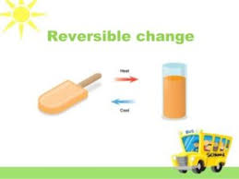
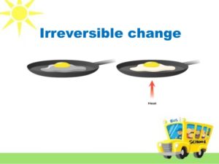
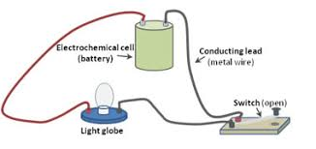
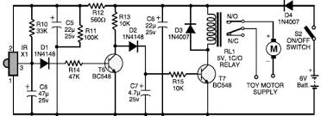
Term 1 Curriculum Overview and Assessments
Science
Unit 1 – Term 1
Unit 1: Making changes
Students investigate changes that can be made to materials and how these changes are classified as reversible or irreversible. They plan investigation methods using fair testing to answer questions. Students identify and assess risks, make observations, accurately record data and develop explanations.
They suggest improvements, which can be made to their methods to improve investigations. Students explore the effects of reversible and irreversible changes in everyday materials and how this scientific understanding is used to solve problems that directly affect people’s lives.
Year 6
Design and Technologies
Unit 1 – (Term 1)
Harvesting good health
In this unit students will explore how competing factors and technologies influence the design of a sustainable service which provides a plant for the preparation of a healthy food product.
The Arts (Visual Art)
In this unit, students explore the design process by identifying a need then designing a product that will enhance school engagement, interaction or purpose.
Students will:
explore and explain the work of designers who respond to culture, time and place, including Aboriginal, Torres Strait Islander and Asian designers, and use this in the development of their own artworks
apply the design process in research and development of a product to meet the needs of the school environment, clients and/or culture using appropriate visual conventions (digital imaging, model making, drawing) to demonstrate vision as a designer
plan the presentation of design process and product with explanation of need and solution to enhance meaning for audience
compare the influence of culture, time and place on design products and use art terminology to explain aesthetic and functional adaptation of design.
Design and Technologies Assessment
Design challenge: Students will design a service that provides an edible plant that can be used to create a healthy food product.
The service will involve the design of the plant’s:
packaging
fact sheet.
Science Assessment
Unit 1: Testing change: Reversible or irreversible?
Experimental investigation
Students plan and conduct an investigation into reversible and irreversible changes, including identifying variables to be changed and measured, describing potential safety risks, identifying improvements to methods and constructing texts to communicate ideas, methods and findings
Part A: Investigating changes
Part B: Observing changes
HASS
Australians as global citizens
In this unit, students will explore the following key inquiry questions:
What does it mean to be an Australian citizen?
How have experiences of democracy and citizenship differed between groups over time and place, including those from and in Asia?
The Arts (Visual Art) Assessment
Assessment Task – Collection of Work
Students will use the design process to develop a concept drawing of a shelter for a particular site and purpose.
Every Student Succeeding
Every student succeeding is the shared vision of Queensland state schools. This strategy underpins regional and school planning to ensure every student receives the support needed to belong to the school community, engage purposefully in learning and experience academic success.
HASS Assessment
Students will investigate the rights and responsibilities of Australian citizens today and the experiences of Australian democracy and citizenship for different groups in the past.

